Slide 1
DRUG DISEASE PREDICTION USING MACHINE LEARNING
Under the Guidance of:
MrS.Laxmi Prasanna
(Asst Professor)
Dept of CSE(AI&ML)
Presented By:
K. Sri Harsha -20R01A6690
S. Vashista Vaagdevi -20R01A66B1
P. Rishwanth -20R01A66A3

Slide 2
INTRODUCTION
Machine learning enables a machine to automatically learn from data, improve performance from experiences, and predict things without being explicitly programmed .The machine learning algorithm has two phases: 1) Training & 2) Testing. To predict the disease from a patient’s symptoms and from the history of the patient. Healthcare issues can be solved efficiently by using Machine Learning Technology.
Popular Machine Learning Applications
Product Recommendations
Image Recognition
Sentiment Analysis
Regulating Healthcare Efficiency and Medical Services

Slide 3
ABSTRACT
Most people in our digital age are prone to ailments as a result of a lack of good food, adequate sleep, and daily exercise. It is critical to know if we are afflicted with sickness at an early stage rather than discovering it later. As a result, illness prediction systems play a significant role since they predict diseases based on symptoms. This disease prediction system employs the Machine Learning algorithm. This approach also recommends medications that are widely used to treat the illness

Slide 4
PURPOSE OF THE PROJECT
The main purpose of using machine learning for drug-disease prediction is to develop accurate and data-driven models that can assist in identifying potential drug candidates and optimizing treatment strategies, ultimately improving healthcare outcomes and drug discovery proces0ses.

Slide 5
EXISTING SYSTEM
There are many prevalent systems used for disease prediction. The existing systems only predict the diseases. The various approaches used for predicting diseases is by using Machine Algorithms such as Naïve Bayes, Decision Tree, Random Forest, k-mean algorithm. Also, one of the approaches to build a disease prediction system is by using Big Data. Prediction using traditional disease risk model usually involves Machine Learning and supervised learning algorithm which uses training data with the labels for the training of the models.

Slide 6
DISADVANTAGES
Patients has to blindly depend on the doctors prescription.
Loss of time and money by frequently consulting a doctor
No quick recovery.

Slide 7
PROPOSED SYSTEM
In the proposed system, a disease prediction model is built using a Machine Learning algorithm that is Random Forest Algorithm. Based on the symptoms that are input by the user, the disease is predicted and the drug that is most commonly prescribed by the doctor is suggested.

Slide 8
ADVANTAGES
It helps the patients to know about the drug and its side effects
Early recovery

Slide 9
UML DIAGRAMS :
1.Class diagram 2.Use Case Diagram

Slide 10
3.Sequence Diagram 4.Collaboration Diagram

Slide 11
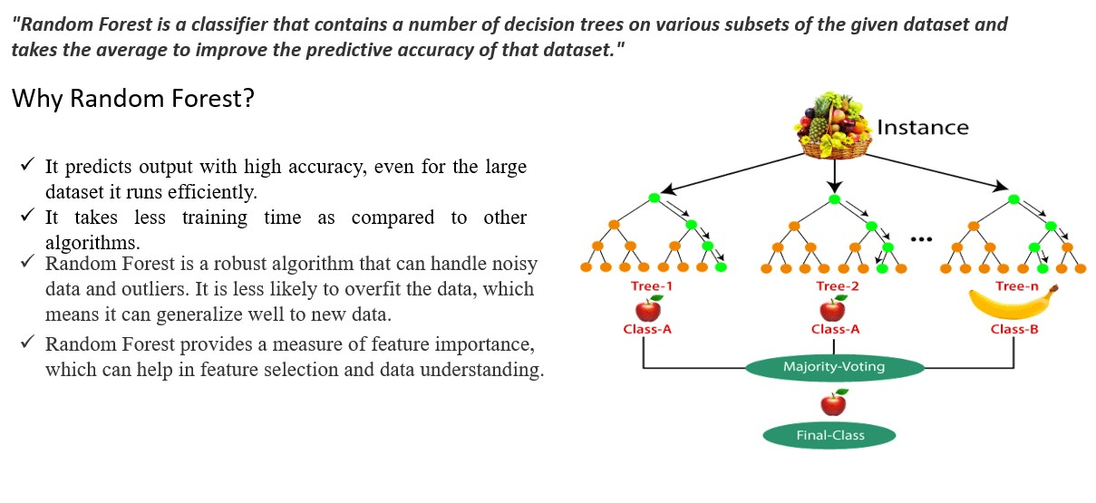
ALGORITHM
RANDOM FOREST:

Slide 12

DECISION TREE CLASSIFIER
A decision tree classifier is a supervised machine learning algorithm that recursively splits a dataset into subsets based on input features, using a series of binary decisions. It constructs a tree structure where each node represents a decision or test on a feature, leading to a final classification or prediction at the leaf nodes. This intuitive approach is used in various applications, such as data classification and regression.

Slide 13
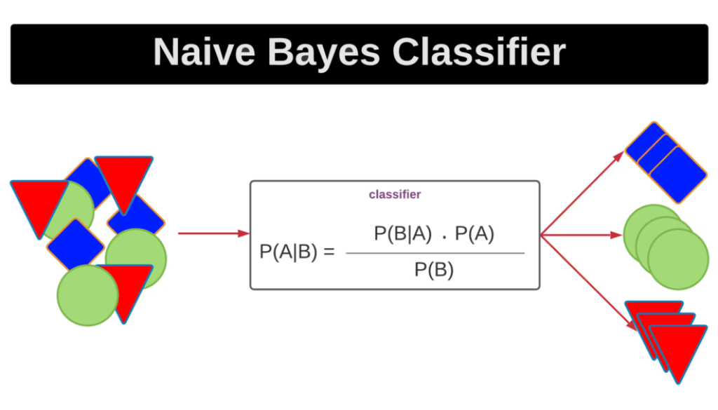
NAIVE BAYES ALGORITHM
The Naive Bayes algorithm is a probabilistic machine learning method used for classification and text analysis tasks. It's based on Bayes' theorem and assumes that features are conditionally independent, which is a simplified, "naive" assumption. Naive Bayes calculates the probability of a class given a set of features and selects the class with the highest probability as the prediction. It's particularly effective for text classification, spam filtering, and sentiment analysis, but it may not work well when the independence assumption is violated in the data.

Slide 14
REQUIREMENTS
HARDWARE REQUIREMENTS:
System : Pentium IV 2.4 GHz.
Hard Disk : 40 GB.
Floppy Drive : 1.44 Mb.
Monitor : 14’ Colour Monitor.
Mouse : Optical Mouse.
Ram : 512 Mb.

Slide 15
SOFTWARE REQUIREMENTS :
Operating system : Windows 7 Ultimate.
Coding Language : Python.
Front-End : Python.
Designing : Html , css , javascript.
Data Base : MySQL.

Slide 16
MODULES :
Modules Which are being used for data exploration, pro processing and for using random forest algorithm are:
NumPy : For simple arrays.
Pandas : For reading the file.
SciKit : Learn- for pre-processing.
Tkinter : For creating the graphical user interface (GUI) for the application.

Slide 17
IMPLEMENTATION :
This project is a Graphical user interface (GUI) for predicting diseases and suggesting drugs based on symptoms. It uses machine learning models like Decision Tree, Random Forest, and Naive Bayes for predictions. Here are the implementation steps for this code:
Import the necessary libraries:
Define the symptoms list (l1) and associated diseases list (disease). These lists contain the symptoms and corresponding diseases used for prediction.
Initialize an empty list (l2) of the same length as l1 to keep track of selected symptoms.
Read the training and testing data CSV files (Training.csv and Testing.csv) into Pandas DataFrames (df and tr).
Replace the disease labels with numerical values in both DataFrames for training and testing.

Slide 18
Create functions for machine learning models:
DecisionTree(): Uses a Decision Tree classifier to predict the disease and displays the result in a text field (t1).
Randomforest(): Uses a Random Forest classifier to predict the disease and displays the result in a text field (t2).
NaiveBayes(): Uses a Naive Bayes classifier to predict the disease and displays the result in a text field (t3).
Create a Tkinter GUI window:
Define labels and entry fields for the patient's name and symptoms (Symptom1 to Symptom5).
Create buttons to trigger the prediction using different models (DecisionTree, randomforest, and NaiveBayes).
Create text fields (t1, t2, t3) to display the prediction results.
Configure the GUI window's appearance and layout.
Start the main GUI event loop by calling root.mainloop().

Slide 19
EXECUTION STEPS :
Install Required Libraries
Prepare Data
Run the Python Script
Use the GUI
View Results
Repeat Prediction
Close the GUI

Slide 20
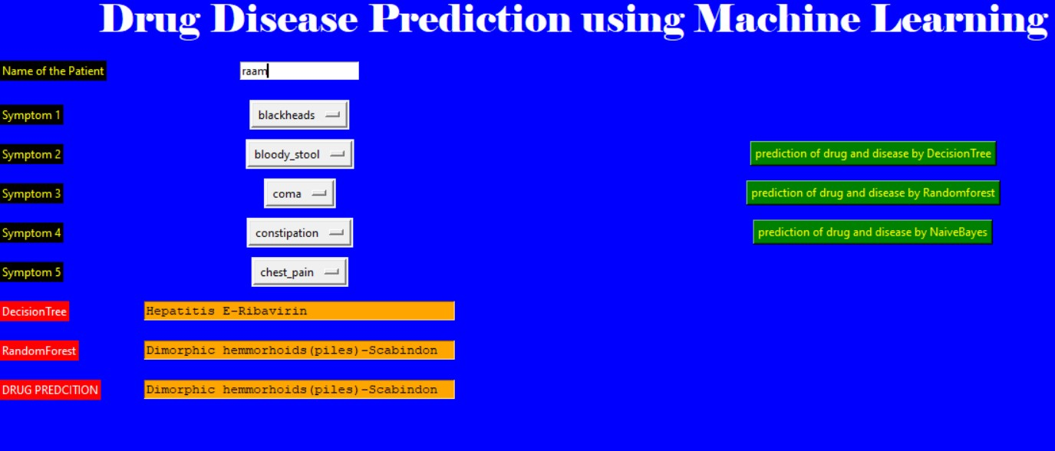
OUTPUT :

Slide 21
CONCLUSION :
In this project, we employed well-known Machine Learning algorithms like Random Forest, SVM, and Naive Bayes to determine a patient's potential ailments based on their reported symptoms. Additionally, our project provides recommendations for suitable medications to address the identified condition, all while ensuring the patient's well-being by offering guidance without replacing the need for a doctor's consultation.
After comparing the accuracy of Random Forest, Naïve Bayes, and Decision Tree algorithms, we've determined that Random Forest consistently outperforms the other two. Random Forest's strength lies in its ensemble approach, which combines multiple decision trees to enhance accuracy. This method mitigates overfitting and captures diverse aspects of the data, making it the preferred choice for achieving higher predictive accuracy in various machine learning applications.

Slide 22
REFERENCES :
Telemedicine, https://www.mohfw.gov.in/pdf/Telemedicine.pdf
Wittich CM, Burkle CM, Lanier WL. Medication errors: an overview for clinicians. Mayo Clin Proc. 2014 Aug;89(8):1116-25.
CHEN, M. R., & WANG, H. F. (2013). The reason and prevention of hospital medication errors. Practical Journal of Clinical Medicine.
Fox, Susannah, and Maeve Duggan. ”Health online 2013. 2013.” URL: http://pewinternet.org/Reports/2013/Health-online.aspx
Drug Review Data Set https://archive.ics.uci.edu/ml/datasets/Drug% 2BReview%2BDataset%2B%2528Drugs.com%2529#

